Slide 1
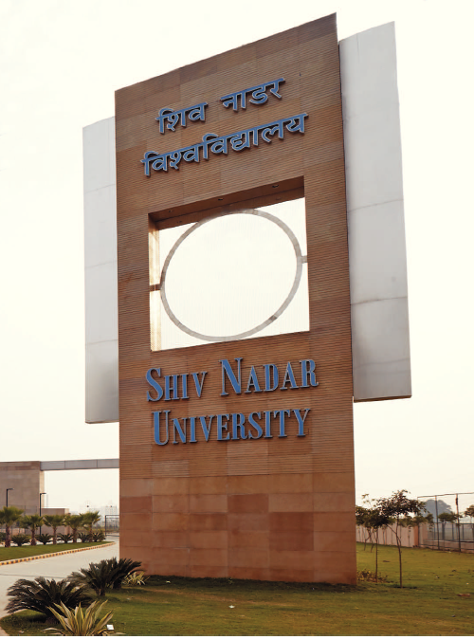
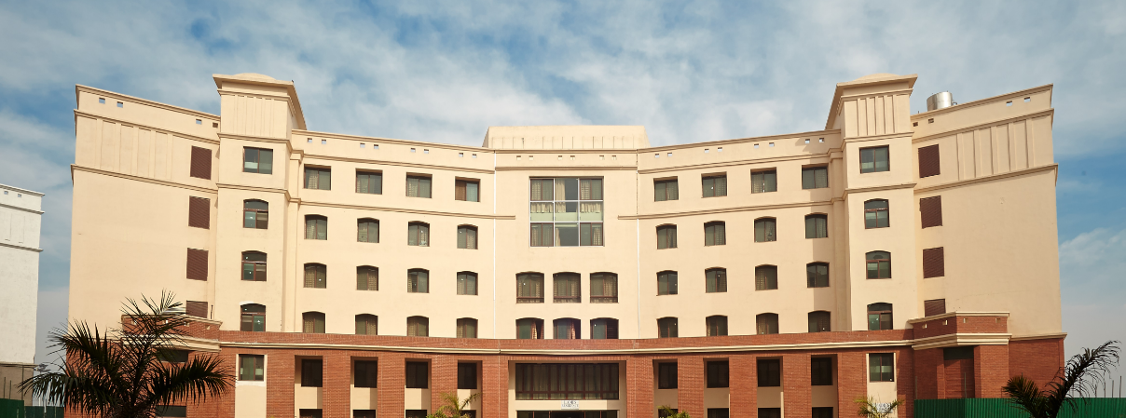
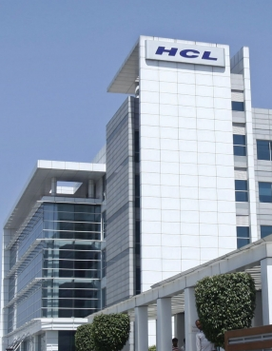



Modern Software Development Practices
Project Management Module
SESSION 1

Slide 2
Agenda
Context setting
Mega projects
Definition
Project management phases
Project management skills
Project Life Cycle

Slide 3
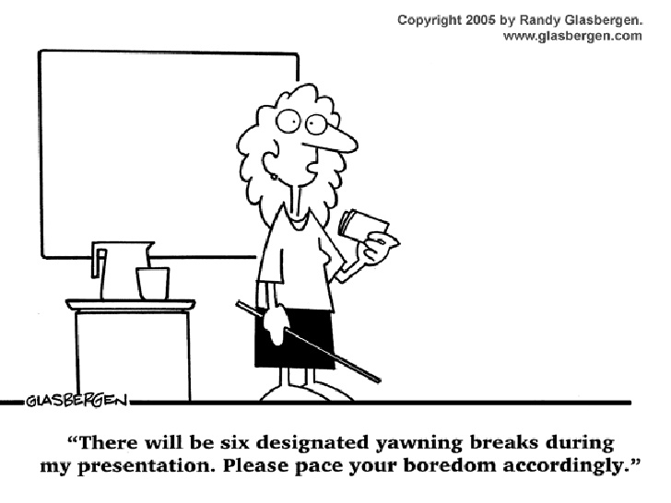

Slide 4
Recap of Previous Session
What is Product Management
“Product Management is the lifecycle and business management of 'what' products get done.”
Stakeholders
Agile methodology
Sprint
PRDs – Product Requirement Document
Prototypes/Wireframes

Slide 5

Project Definition
What is a Project ?
What are some definitions ?
Examples

Slide 6
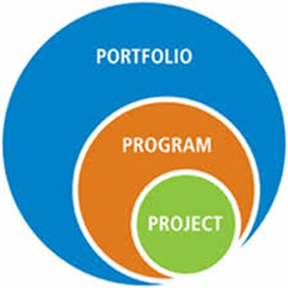
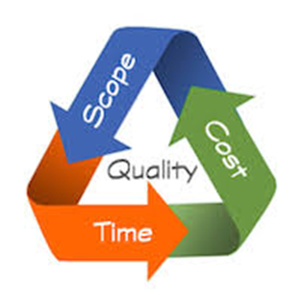
Lets Start with a Few PMI Definitions
• PMBOK ® - the Project Management Book of Knowledge from which PMI defines terms, standards, and good practices
• Portfolio – Projects, programs, and operations managed as a group to achieve strategic objectives
• Program - A group of projects and program activities managed in a coordinated way
• Project – a temporary endeavor undertaken to create a unique product, service, or result
• Project Management – the application of knowledge, skills, tools, and techniques to project management activities to meet project requirements
• Project Manager – the person authorized by the performing organization to direct the team accountable for realizing project objectives
• Project Stakeholder – includes all project team members and anyone impacted by or impacting the project
• Triple Constraint – the foundation of project management is balancing scope, time, and cost. Quality is at the center of the triple constraint

Slide 7

Definition
A project is a temporary endeavour undertaken to create a unique product or service.
It is
performed by people
constrained by limited resources
planned, executed and controlled
A temporary process, which has a clearly defined start and end time,
With a set of tasks and a budget, developed to accomplish a
well-defined objective
PMI has defined Project as “A combination of human and non-human resources, pooled together in a temporary organization to achieve a specific purpose”.

Slide 8
Definition - Another one
“Unique process consisting of a set of coordinated and controlled activities with start and finish dates, undertaken to achieve an objective conforming to specific requirements, including constraints of time, cost, quality and resources”
A Project is a planned set of activities
A Project has a scope
A Project has time, cost, quality and resource constraints

Slide 9
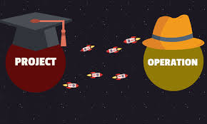
Difference between Project /Operations/ Program and Portfolio
Project
A project is a temporary endeavor undertaken to create a unique product, service, or result.”
Although, the wordings of both definitions are different, meaning is same, and you can conclude that:
The nature of the project is temporary, and
The project is undertaken to produce a unique output, for example, a product, service, or a result.
Operations
Operations are the ongoing execution of activities that produce the same output, or provide a repetitive service.
Operations don’t produce anything new, but they are necessary to maintain and sustain the system.
Operations are used to run regular business models, achieve the goals of the business, and sustain the business.
Operations are different as opposed to projects, which are known for their uniqueness.
Operations are permanent in nature, and their only constraint is to make profit for the organisation.

Slide 10
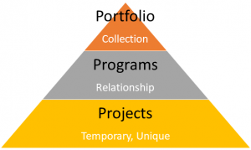
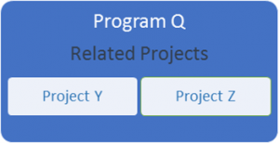
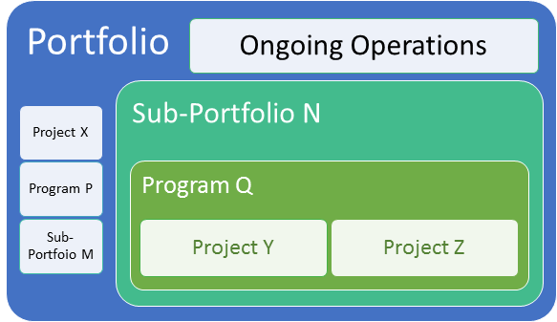
Difference between Project /Operations/ Program and Portfolio
Program
A group of related projects, programs & subprograms, activities managed in a coordinated way to obtain benefits not available from managing them individually.
Portfolio
Projects, programs, sub-portfolios, and operations managed as a group to achieve strategic objectives.

Slide 11
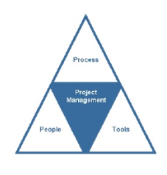
Project Ecosystem
Every Project is dependent upon processes, people and tools. They determine how the work gets done. But these three essential elements are not equals. Each has its own strengths and weakness and provides different values to projects
Process
People
Tools

Slide 12
Project Ecosystem
Process – The policies, procedures and the roles and responsibilities required in managing development projects. Processes determine how the work needs to be accomplished.
People – The skill and capabilities of the people in charge of managing the project and whether or not they follow the processes and procedures to ensure the quality of the services provided by the organization
Tools – The techniques and the devices selected by the organization with the purpose to facilities the management of the people.

Slide 13
Question
What are the project constraints ?

Slide 14

Project Constraints
A development project has to manage four basic constraints : scope, schedule, budget and quality
The success of a project depends heavily on the ability, skills and knowledge of the project manager to take into consideration these constraints and develop the plans and processes to keep them in balance.

Slide 15
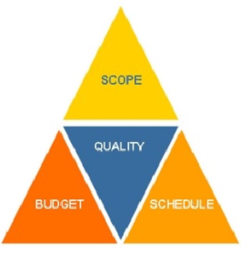
Project Constraints
Scope - The boundaries of the project
Schedule – The time to complete the project activities
Budget – The funding available to cover all the expenses of the project.
Quality – Achieving the expectations of the stakeholders

Slide 16
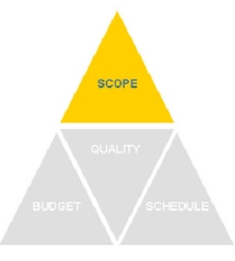
Project Constraint - Scope
Scope – Is what the project is trying to achieve, it entails all the work involved in delivering the project outcomes and the processes used to produce them. Scope is the boundary of a project, it is what the beneficiaries and the donors expect from the Project.
*Mutually Agreed statement of work

Slide 17
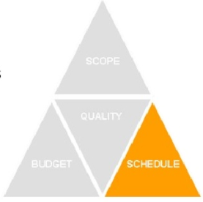
Project Constraint - Schedule
Schedule – Is defined as the time required to complete the project. It is an approximation of the duration of all the activities in the project. Schedule constraints include specific dates to deliver an activity or complete the project.

Slide 18
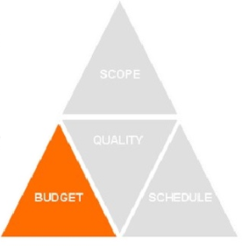
Project Constraint- Budget
Budget – Are the funds approved for the project, they include all the required expenses needed in order to deliver the project within scope and schedule. A number of constraints, financial, political and organizational may dictate the methods by which resources such as personnel, equipment, services and materials are required.

Slide 19
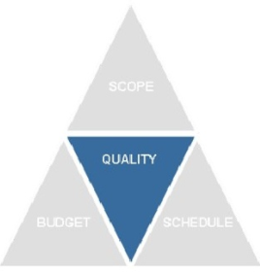
Project Constraint- Quality
Quality – Fourth constraint and is defined as delivering the project outcomes according to the stated or implied needs and expectations of the project beneficiaries and the donor agency. Quality is also defined as the conformance to requirements or fitness for use.

Slide 20
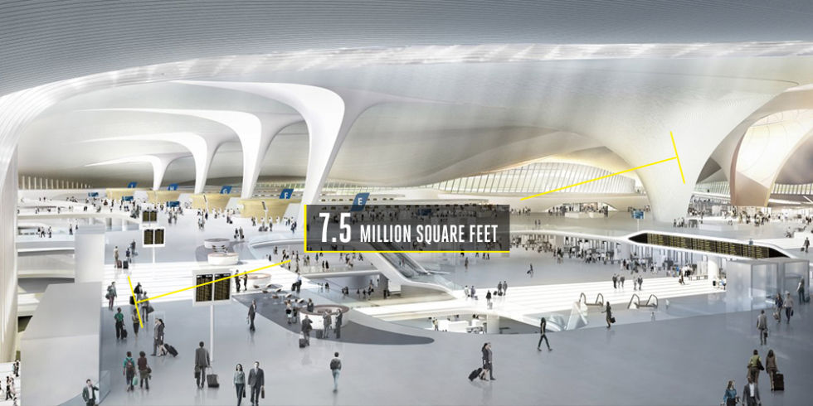
World famous projects - 1
Beijing Daxing International Airport, China
Time to build: 5 years Cost to build: $13 billion
This is the home of the world's largest airport terminal, the gleaming Terminal 1, designed by Zaha Hadid. Built to accommodate 100 million passengers per year and with seven runways and 7.5 million square feet of the space, the airport's first phase should finish in 2018, with the rest slated to wrap up in 2025.

Slide 21
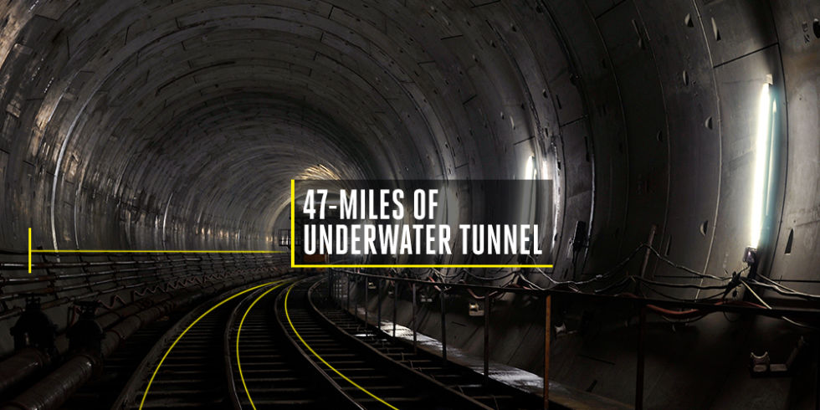
World famous projects - 2
Marmaray Tunnel, Turkey
Time to build: 9 years Cost to build: $4.5 billion
It took nine years and $4.5 billion to build, but the 47-mile underwater railway tunnel connects the European and Asian sides of town, giving Istanbul a new rail line into and out of the city when it opened in 2013.

Slide 22
World famous projects – 3 (Closer home)
Delhi Metro Phase 1
Time to build: 8 years Cost to build: The total bill for the 60-odd km of the Metro is over Rs 10,500 crore* (@ Rs 175 crore per km)
Physical construction work on the Delhi Metro started on 1 October 1998. After the previous problems experienced by the Kolkata Metro, which was badly delayed and 12 times over budget due to "political meddling, technical problems and bureaucratic delays", DMRC is a special purpose organization vested with great autonomy and powers to execute this gigantic project involving many technical complexities, under a difficult urban environment and within a very limited time frame. DMRC was given full powers to hire people, decide on tenders and control funds. The DMRC then consulted the Hong Kong MTRC on rapid transit operation and construction techniques. As a result, construction proceeded smoothly, except for one major disagreement in 2000, where the Ministry of Railways forced the system to use broad gauge despite the DMRC's preference for standard gauge.
The first line of the Delhi Metro was inaugurated on 24 December 2002,and thus, it became the second underground rapid transit system in India, after the Kolkata Metro. The first phase of the project was completed in 2006,[on budget and almost three years ahead of schedule, an achievement described by Business Week as "nothing short of a miracle".
.

Slide 23
Some more examples
Developing a new product or service
Effecting change in a structure, staffing or style of an organisation
Designing a new transportation vehicle
Developing or acquiring a new or modified information system
Constructing a building or facility
Building a water system for a community in a developing country
running at campaign for political office
implementing a new business procedure or process

Slide 24
Project Management
Management : Management is the technique of understanding the problems, needs and controlling the use of Resources, Cost, Time, Scope and Quality.
Project Management : Application of knowledge, skills , tools & techniques to project activities in order to meet stakeholder needs & expectations from a project.
Needs : stated part of the project
Expectations : unstated part of the project
“Completion of Project on time within Budget without comprising Quality”

Slide 25

Definition - Another one
Project Management is the application of knowledge, skills, tools and techniques to project activities in order to meet or exceed stakeholders’ needs and expectations from a project.
Project management is the discipline of organizing and managing resources in such a way that the project is completed within defined scope, quality, time and cost constraints.

Slide 26
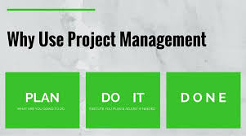
Why do companies use PM?
• To handle projects effectively in an organization.
• To define the project and agree with the customer
• To plan and assess resource needs for the project
• To estimate project cost and make proposals
• To plan & schedule activities in a project.
• To allocate the right resource at the right time.
• To assess risk and failure points and make backup plans.
• To lead a project team effectively and communicate well

Slide 27
Exercise 1
Write down three attributes of a good Project Manager

Slide 28
A good project manager
Takes ownership of the whole project
Is proactive not reactive
Adequately plans the project
Is Decisive
Is a Good Communicator
Manages by data and facts not uniformed optimism
Leads by example
Has sound Judgement
Is a Motivator
Is Diplomatic
Can Delegate

Slide 29
What is Project Life Cycle Vs Project Management Process
PMBOK defines project life cycle as “the series of phases that a project passes through from its initiation to its closure”
It can follow one of the several available models and methodologies like Waterfall, Agile etc.
Project life cycle: “Collectively the project phases are known as the project life cycle.”

Slide 30
Project Life Cycle
What you need to do “to do” the work
Gather requirements, complete a System requirement document, high level design document, coding, testing and delivery
All life cycles essentially deal with the activities that are required to be done in order to deliver the project.
Activities that are required to do a project

Slide 31
Project Management Process
What you do to manage the work
All projects, no matter what industry and no matter what life cycle they follow, will always have the five project management processes.
Remember that a project life cycle is made up of a number of phases.
There are four key parts that any project generally follows, known in the PMBOK Guide as the generic project life cycle:
Starting
Organizing and preparing
Carrying out the work
Closing

Slide 32
How do development projects get started?

Slide 33
Project Management Phases
Process Groups
Initiation
Closing
Planning
Executing
Monitoring & Control
Activities
Define a new project or new phase, identify stakeholders, and obtain authorization “Authorize the Work” | Develop an integrated project management plan to attain project objectives “Plan the Work” | Complete the work and satisfy project Objectives “Work the Plan | Track and review project progress and performance; manage variance and change “Control the Plan | Finalize all activities and formally close the project or phase “End the Work”
• Project Charter • Stakeholder Register | •Project Mgt. Plans & Related Documents - Scope - Requirements Schedule Cost Quality Human Resources Communication Risk Procurement Change Stakeholders | • Project Deliverables • Work Performance Data • Team Performance Assessments • Project Communications (e.g. status reports) • Selected Suppliers & Agreements • Change Requests • Issue Log | • Change Logs • Approved Change Requests • Work Performance Information • Schedule Forecasts • Cost Forecasts • Updates to Project Plan • Quality Control Measurements • Verified Deliverable • Accepted Deliverable | • Final Product, Service, or Result (i.e. purpose of project) • Closed Procurement (e.g. formal signature of acceptance)
Key Outputs

Slide 34
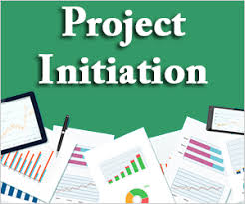
Initiation Phase
The Project Initiation Phase is the 1st phase in the Project Management Life Cycle, as it involves starting up a new project. You can start a new project by defining its objectives, scope, purpose and deliverables to be produced.
Major Setup during planning include
Project charter
Feasibility Study, Scope and Objectives
Organize Project team
Project Kick off
Project Management Plans
Establish clear statement of what is to be done (WBS)
Establish Risks to be Managed
Establish Costs and Durations
Establish Resources Required

Slide 35
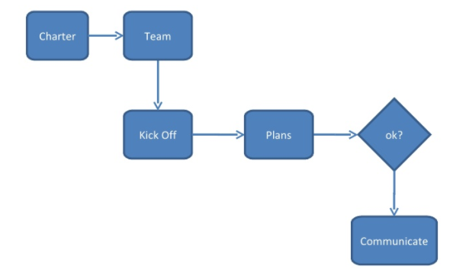
Project Planning

Slide 36
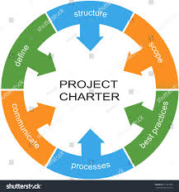
Project Charter
A project charter formally authorizes the project and the project manager to apply resources to project activities. Per PMI, without a charter, there is no project.
A typical charter will identify:
Business need or justification
Scope (high level)
Objectives (such as the intended product, service, or result)
Requirements (high level)
Risks (high level)
Assumptions and constraints
Stakeholders (primary)
Timing (anticipated)
Costs (anticipated)
The charter must be signed by someone who can invest authority for the project (typically senior management or a sponsor)

Slide 37
Project Management Plan
The project management plan is the collection of all plans and related documents pertaining to planning, executing, monitoring, controlling, and closing the project
Project Management Plan
Procurement
Risk
Configuration
Quality
Communication
Change
Scope
Cost
Process Improvement
Stakeholder
Schedule

Slide 38
Project Management Plan
Project Objectives, Scope, Deliverables
Stakeholders (Internal & External)
Work to be done (WBS)
Project Organization and Resources (OBS)
Project Costings (CBS)
Project Schedule
Procurement/Contract Strategy
Risk Management
Quality management
Change Management

Slide 39
Project Management Tools
MS Project
MPP
Meetings(Skype, Webex)
Reports
Emails
Trello
JIRA
Confluence

Slide 40
Next Sessions
Will cover the different Project Management Processes

Slide 41
Websites to look at as Project Management
https://www.pmi.org – Project Management
https://www.cebglobal.com/ -(PMO Leadership Council)
https://www.projectmanagement.com/- Webnairs
https://www.capterra.com/project-management-software/– Project Management Tools
https://www.slideshare.net/ostephens/project-management-tools-2014562- Project Management Tools
https://www.pmbypm.com/difference-project-program-and-portfolio/
https://www.youtube.com/watch?v=9LSnINglkQA
https://www.youtube.com/watch?v=6Or_9IRQHi4

Slide 42
Thank You

